Slide 1
Tic-Tac-Toe AI Using Minimax Algorithm and Alpha-Beta Pruning for Optimal Decision-Making

Slide 2
Introduction
Objective: Develop an AI that plays Tic-Tac-Toe optimally.
Key Features:
The AI Uses the Minimax Algorithm for decision-making.
The AI will be Optimized with Alpha-Beta Pruning for efficiency.
It Ensures the AI never loses if played optimally..

Slide 3
Why Tic-Tac-Toe?
It is a simple game that provides a perfect environment to apply game tree search techniques.
It helps us understand decision-making in artificial intelligence.

Slide 4
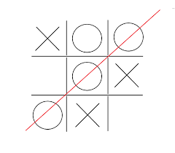
Game Rules (Brief)
The game will be played on a 3x3 board.
Players place ‘X’ (This will be done by AI) and ‘O’ (by Human).
The first player who will be able to align three marks horizontally, vertically, or diagonally wins.
If the game does not have any winners, the game ends in a draw.

Slide 5
Role of Minimax Algorithm
Minmax is a recursive decision-making algorithm used in two-player games.
How Minmax Works:
The AI (Maximizer) selects the move with the highest possible advantage.
The opponent (Minimizer) tries to counteract by selecting moves that minimize the AI’s advantage.
Game State Scoring:
If the AI wins, the score will be +1. If the human wins, the score will be -1. If it’s a draw, the score will be 0.
Ensures that the AI always selects the best possible move.

Slide 6
Role of Alpha-Beta Pruning
It is computationally expensive without pruning
Alpha-Beta pruning makes the AI more efficient by eliminating unnecessary calculations
How It Works:
Alpha represents the best choice for the AI (Maximizer).
Beta represents the best choice for the opponent (Minimizer).
If a move doesn’t improve the outcome, further exploration of that branch is skipped.
Performance Gain:
Performance Gain Reduces the number of nodes evaluated by almost 40-50%, speeding up decision-making.

Slide 7
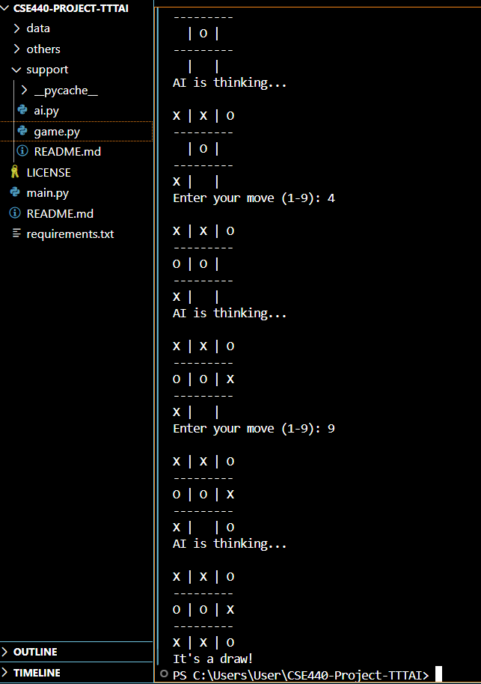
Update and Results
The Minimax algorithm has been successfully implemented, and the AI can now play Tic-Tac-Toe optimally.
The AI consistently makes the best moves, ensuring a win or draw while efficiently blocking opponent strategies.

Slide 8
Thank you
Nandini Das 2031326642
Syed Riaz Us Salatin Yeasin 2031061642
Tousif Iqbal – 2012814642
Nafiz Haider Chowdhury 1721587642

